Slide 1
GEOG0113 Lecture 003 The Terrestrial Carbon Cycle
M. Mokroš
H. Heorton
UCL Geography
& NERC NCEO
Slides by Prof. P. Lewis

Slide 2
Aims of lecture
In this lecture, we will:
look in detail at the terrestrial carbon cycle
provide an overview of relevant biogeochemical processes

Slide 3
Definition - Terrestrial Carbon
carbon that is stored in the vegetation and soils of the Earth’s land surface
The Earth Systems Science:
Maintain focus on interactions between different spheres, but understand processes and interactions within each sphere.

Slide 4
Terrestrial Carbon
Justification:
major role it plays in anthropogenic climate change.
Also:
the role that terrestrial vegetation plays in biodiversity;
role of vegetation in providing food and fuel.

Slide 5
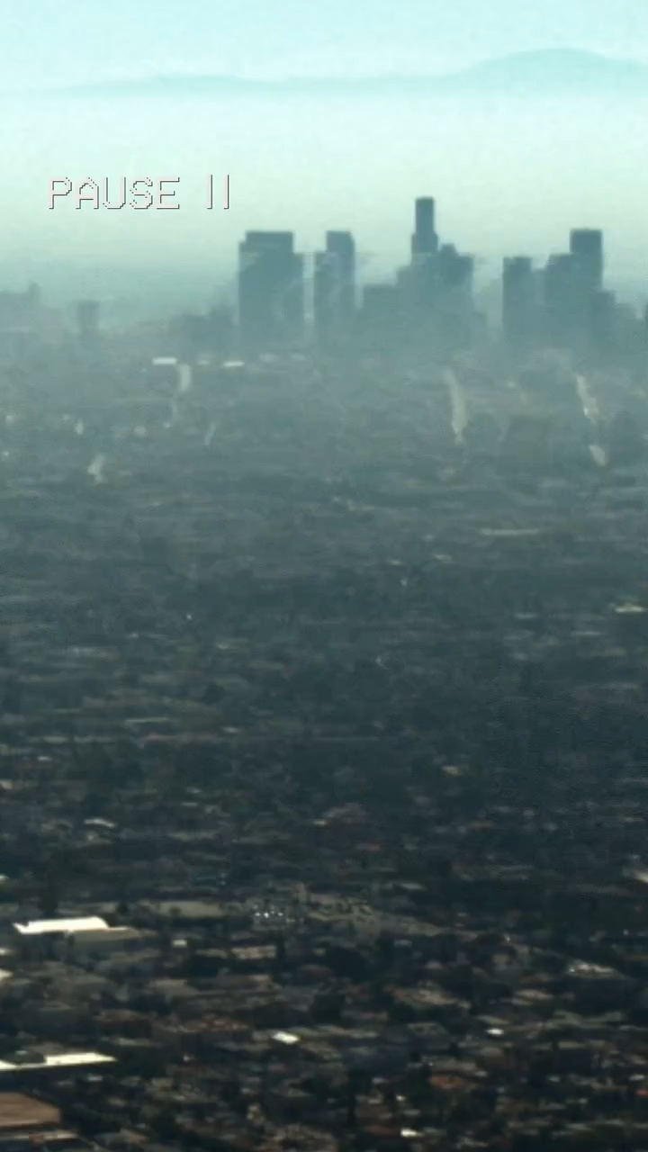
Video from NASAEARTH Instagram channel https://www.instagram.com/nasaearth/
Part of a series (recommended)
https://www.instagram.com/p/CnU5d9mjlVI/

Slide 6
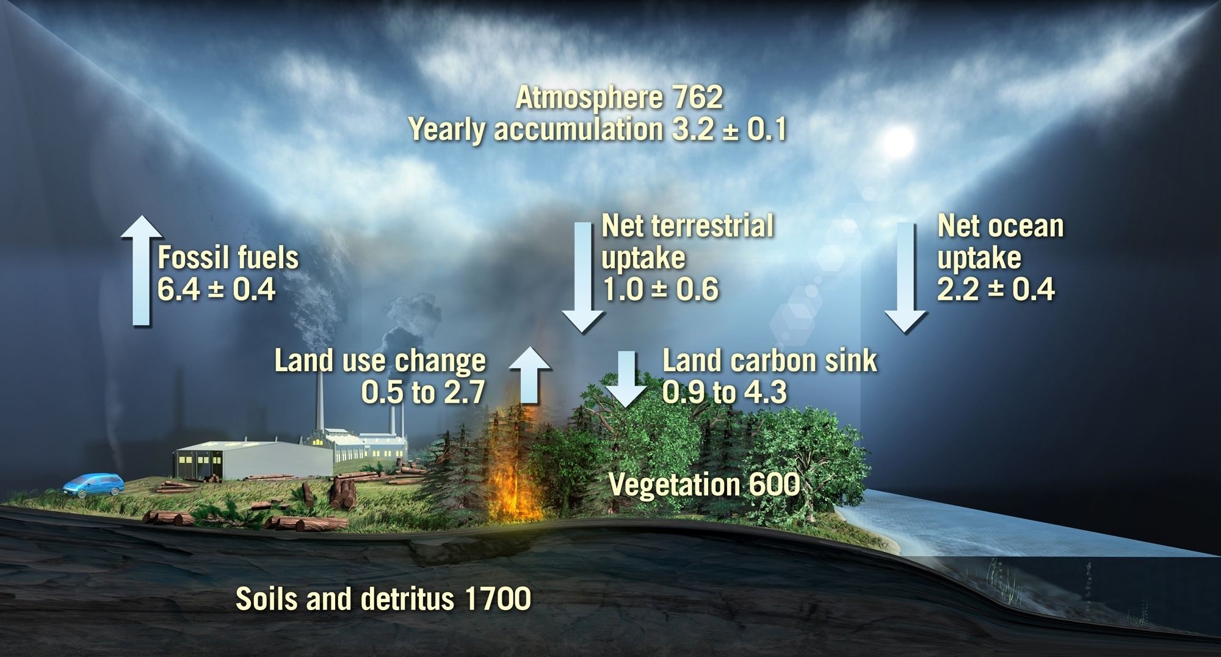
The global carbon cycle for the 1990s
Values from IPCC 2007. Units: Gigatons of carbon/ yr
Notes:
Values from IPCC 2007 – average for 90s
FF
Atmos increase
Balance made up by net flows to ocean and land
Important to note that the net flux to the land has 2 components
Anthropogenic source (LUC – not just fire)
Sink term, some of which is die to forest growth
Also shown on slide are C pools
600 Gtc in veg biomass, comparable to atmos
Soils poll, 3 times larger , but less mobile on annual to decadal t-scales
BIOMASS addresses the veg. carbon pools and fluxes associated with forests
Link: I now want to focus on the uncertainties in the fluxes

Slide 7
Carbon Sources and Sinks (to the atmosphere)
Sources and sinks
Historical and future C emissions to the atmosphere (C sources)
Uptake of C (e.g. photosynthesis)
Net uptake to atmosphere: difference

Slide 8
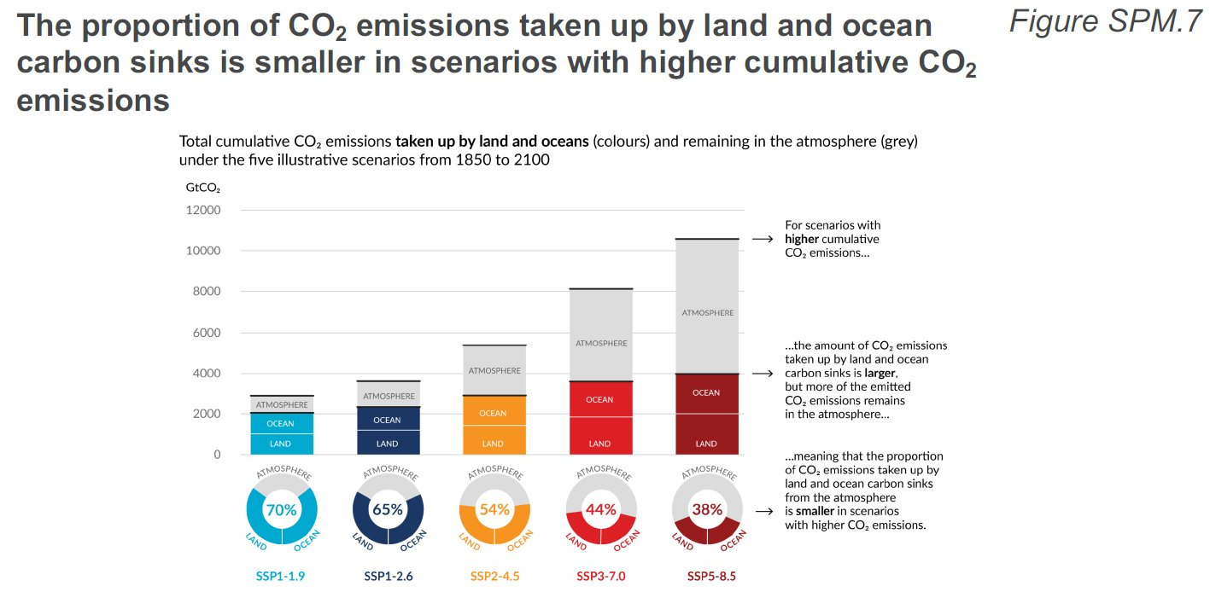
Carbon Sources and Sinks (to the atmosphere)
five illustrative scenarios are referred to as SSPx-y, where ‘SSPx’ refers to the Shared Socio-economic Pathway or ‘SSP’ describing the socio-economic trends underlying the scenario, and ‘y’ refers to the approximate level of radiative forcing (in W m–2) resulting from the scenario in the year 2100
Important to understand role and functioning of sinks
Notes:
More CO2 emission, then more absolute amount of CO2 taken up by ocean and land
BUT lower proportion uptake: higher proportion stays in the atmiosphere
Land and ocean have taken up a near-constant proportion (globally about 56% per year) of CO2 emissions from human activities over the past six decades, with regional differences (high confidence).
Throughout this report, the five illustrative scenarios are referred to as SSPx-y, where ‘SSPx’ refers to the Shared Socio-economic Pathway or ‘SSP’ describing the socio-economic trends underlying the scenario, and ‘y’ refers to the approximate level of radiative forcing (in W m–2) resulting from the scenario in the year 2100. A detailed comparison to scenarios used in earlier IPCC reports is provided in Section TS1.3 and 1.6 and 4.6. The SSPs that underlie the specific forcing scenarios used to drive climate models are not assessed by WGI. Rather, the SSPx-y labelling ensures traceability to the underlying literature in which specific forcing pathways are used as input to the climate models. IPCC is neutral with regard to the assumptions underlying the SSPs, which do not cover all possible scenarios. Alternative scenarios may be considered or developed.

Slide 9
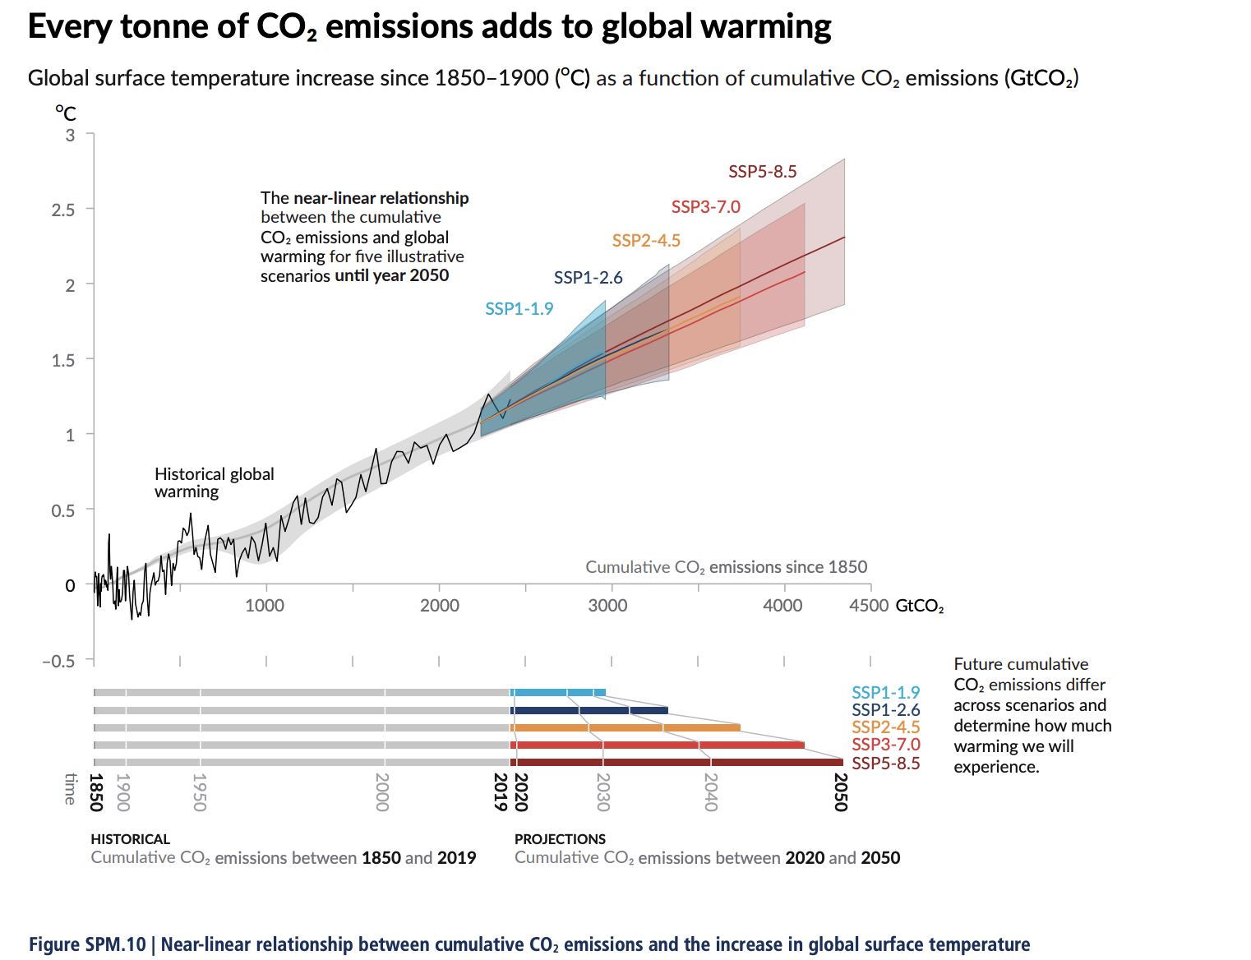
T increase depends on cumulative C emissions
Global mean surface temperature increase as a function of cumulative total global CO2 emissions from various lines of evidence.
AR6: Figure SPM.10
Notes:
Figure SPM.10 | Near-linear relationship between cumulative CO2 emissions and the increase in global surface temperature Top panel: Historical data (thin black line) shows observed global surface temperature increase in °C since 1850–1900 as a function of historical cumulative carbon dioxide (CO2) emissions in GtCO2 from 1850 to 2019. The grey range with its central line shows a corresponding estimate of the historical human-caused surface warming (see Figure SPM.2). Coloured areas show the assessed very likely range of global surface temperature projections, and thick coloured central lines show the median estimate as a function of cumulative CO2 emissions from 2020 until year 2050 for the set of illustrative scenarios (SSP1-1.9, SSP1-2.6, SSP2-4.5, SSP3-7.0, and SSP5-8.5; see Figure SPM.4). Projections use the cumulative CO2 emissions of each respective scenario, and the projected global warming includes the contribution from all anthropogenic forcers. The relationship is illustrated over the domain of cumulative CO2 emissions for which there is high confidence that the transient climate response to cumulative CO2 emissions (TCRE) remains constant, and for the time period from 1850 to 2050 over which global CO2 emissions remain net positive under all illustrative scenarios, as there is limited evidence supporting the quantitative application of TCRE to estimate temperature evolution under net negative CO2 emissions. Bottom panel: Historical and projected cumulative CO2 emissions in GtCO2 for the respective scenarios. {Section 5.5, Figure 5.31, Figure TS.18}
https://www.ipcc.ch/report/ar6/wg1/downloads/report/IPCC_AR6_WGI_SPM_final.pdf

Slide 10
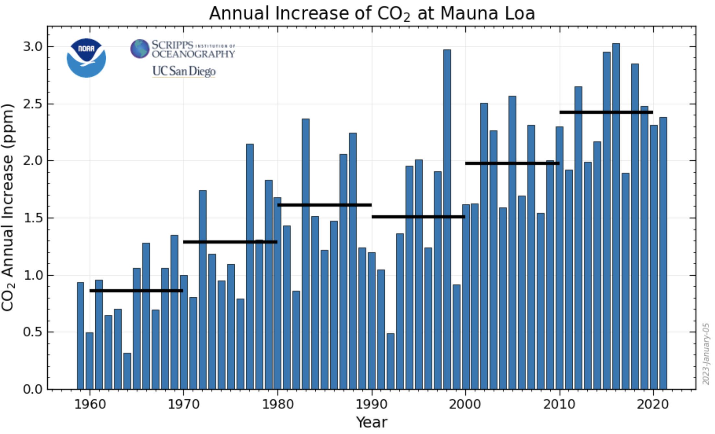
CO2 growth rate
Notes:
The annual mean growth rate of CO2 in the atmosphere is around 2.5 ppmv of CO2, from which it can be inferred that just over 2.5 ppmv of CO2 must enter other fast pools of carbon.

Slide 11
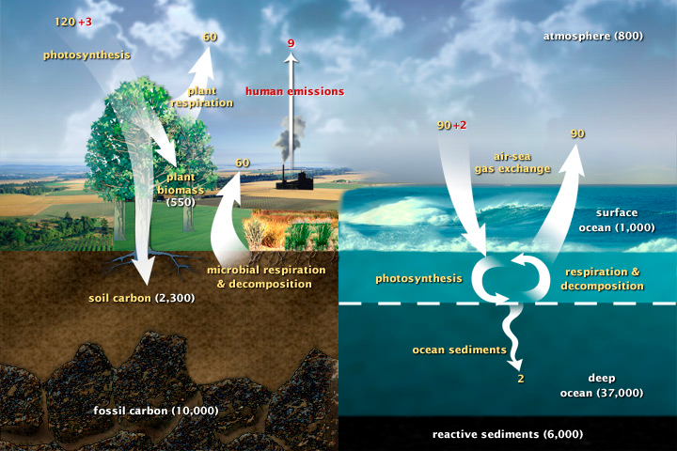
The Carbon Cycle
Notes:
This diagram of the fast carbon cycle shows the movement of carbon between land, atmosphere, and oceans. Yellow numbers are natural fluxes, and red are human contributions in gigatons of carbon per year. White numbers indicate stored carbon

Slide 12
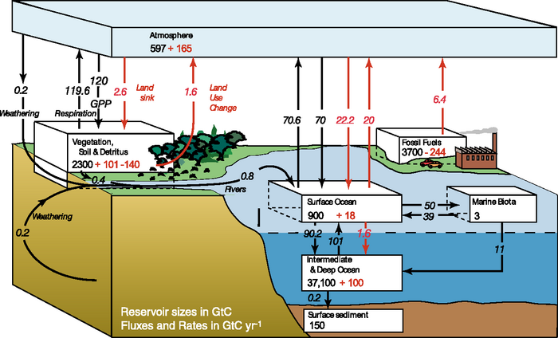
Carbon Cycle
Notes:
The figures given by the IPCC in AR4 are 4.1 +/- 0.1 GtC y-1 annual mean CO2 growth rate for the period 2000 to 2005 with annual emissions from fossil fuel burning and cement production at 7.2 +/- 0.3 GtC y-1 for that same period. The sink to the ocean carbon pool is estimated as 2.2 +/- 0.5 GtC y-1 and that to the land pool as 0.9 +/- 0.6 GtC y-1 (0.9 + 2.2 + 4.1 = 7.2).
For example, the land sink of around 0.9 +/- 0.6 GtCy-1 is itself composed of a balance between a primary production land sink and a land use change source.

Slide 13

The mean global carbon cycle for the 1990s
9
8
7
6
5
4
3
2
1
High
Residual land sink
High
Residual land sink
Land use change flux
Land use change flux
Low
Low
Fossil fuel emissions
Net ocean
sink
GtC/year
Atmospheric increase
AnthropogenicSources
Changes in C pools
User Consultation Meeting, Lisbon, Portugal, 20-21 January 2009 biomass
Notes:
Good measurements and error estimates. Note error bars – ~20% for ocean.
Anthropogenic sources not complete – need LUC (mainly trop deforestation)
In IPCC, no error bars on this estimate, just a range, from low to high
Here’s low; for the budget to balance this implies a sink term as shown.
Here’s the high, and the corresponding sink term
If we think of the LUC range as uncertainty, it is about 70% - much greater than for the ocean flux. It dominates the error budget .
The sink term is a residual, just to make things balance. Since we have little idea of its actual magnitude, explaining it is fraught with uncertainty. Certainly uptake into biomass is part of this term
Will talk about biomass in context of 2 top boxes; the left is a decrease in biomass, part of the right is forest growth.

Slide 14
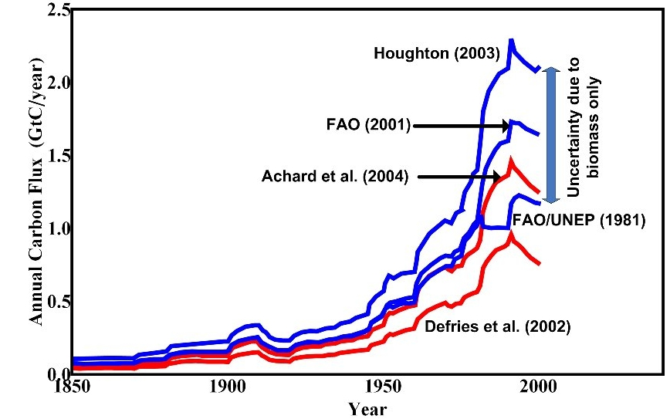
Uncertainty in carbon emissions due to biomass
Humid Tropical
Deforestation
Notes:
Uncertainty of 1 GtC pa due entirely to uncertainty in mean biomass
Also, note that these calculations take no account of the possibility that deforestaion may preferentially take areas of high or low biomass
To do this properly, we need
Maps of biomass to know what has actually been deforestsed
Scale of maps need to be comparable with the deforestation process – around 100 m
Check values of area deforested

Slide 15
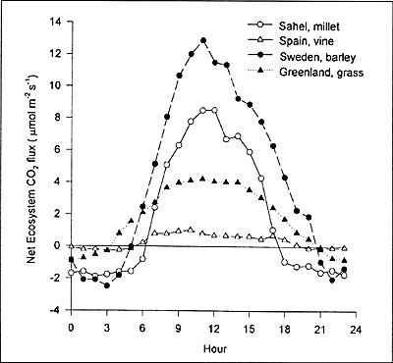
Biogeochemical processes
Net Ecosystem CO2 flux: NEP
Diurnal variations
Soegaard (1999)
Notes:
Explain .. Daytime flux positive, nighttime negative … GPP photosynthesis & (autotrophic) respiration

Slide 16
Definition – Net Primary Production (NPP)
Definition – Net Ecosystem Production (NEP)
Total CO₂ change observed, Photosynthesis – Respiration
This can be observed from flux towers, but will include all processes, including those in soil (decay for example)
Also called Net Ecosystem Exchange (NEE)
Definition – Gross Primary Production (GPP)
Total CO₂ Absorbed During Photosynthesis
Can be estimated from widescale remote sensing data (i.e. Satellite images)
Total change in Atmo. CO₂ due to above ground biomass.
GPP – Respiration (R_{a})
Directly relatable to GPP – so can potentially be estimated from remote sensing data
Notes:
Explain .. Daytime flux positive, nighttime negative … GPP photosynthesis & (autotrophic) respiration

Slide 17
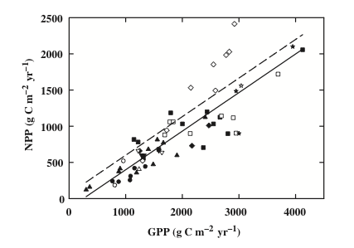
NPP/GPP: Carbon use efficiency (CUE)
DeLucia et al (1999)
See notes for paper link
Notes:
Assumed approx 0.5 but can vary significantly
CUE is C use efficiency

Slide 18
Definition - Carbon use efficiency (CUE = NPP/GPP)
The ratio of
CO₂ removed from the atmosphere due to photosynthesis (GPP)
- to -
Total change in atmospheric CO₂ due to above ground biomas
”Efficiency” as CUE = 1 represents a plant that can reuse all energy it takes from the sun
DeLucia et al (1999)
See notes for paper link
Notes:
Assumed approx 0.5 but can vary significantly
CUE is C use efficiency

Slide 19
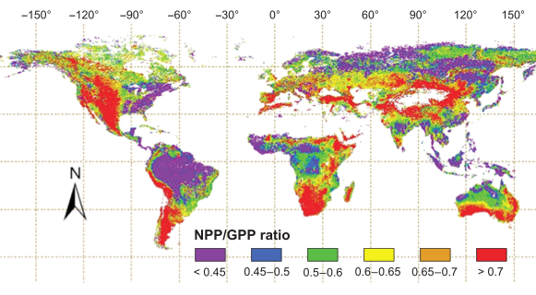
NPP/GPP
Notes:
Zhang et al GCB 2009

Slide 20
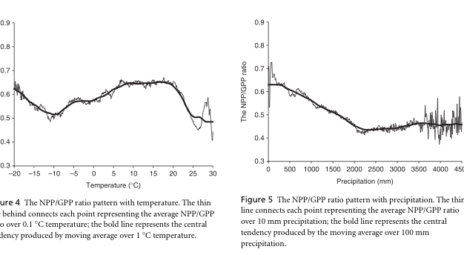
CUE dependencies
Notes:
Zhang et al. GCB 2009
Strong precip dependence, also T, altitude … discuss

Slide 21
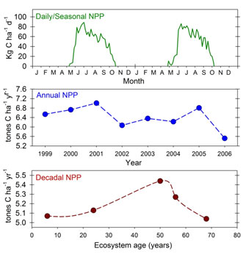
NPP temporal scales
Notes:
dicsuss

Slide 22
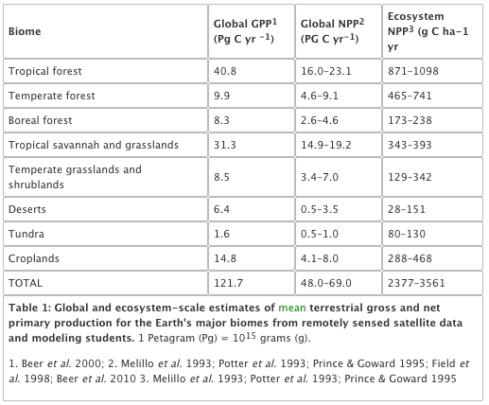
NPP biomes
Notes:
Gough, C. M. (2011) Terrestrial Primary Production: Fuel for Life. Nature Education Knowledge 2(2):1
Nice website …

Slide 23
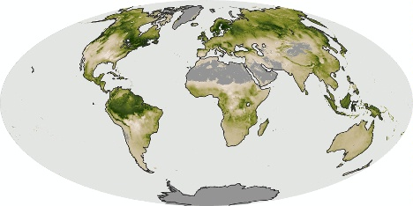
NPP: July 2006

Slide 24
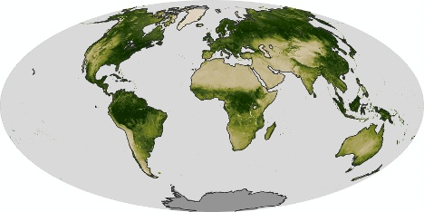
NDVI: July 2006

Slide 25
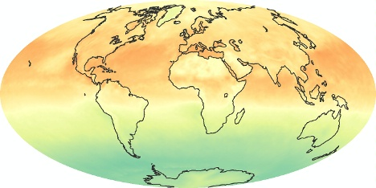
Net radiation: July 2006

Slide 26
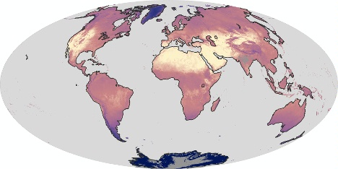
LST (Land Surface Temp.): July 2006

Slide 27
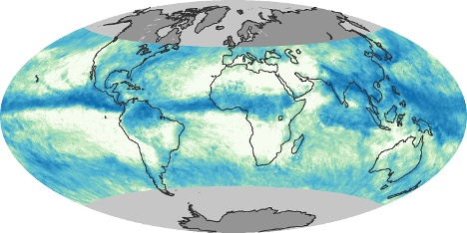
Precip.: July 2006

Slide 28
NPP: July 2006

Slide 29
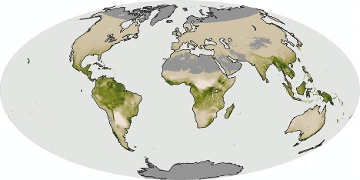
NPP: Dec 2006

Slide 30
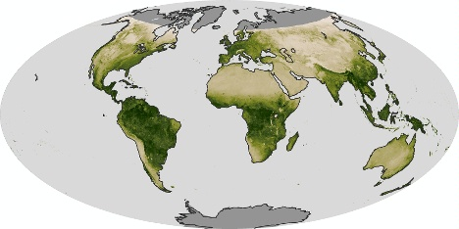
NDVI: Dec 2006

Slide 31
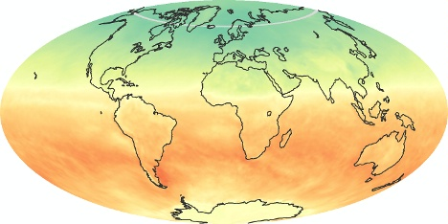
Net radiation: Dec 2006

Slide 32
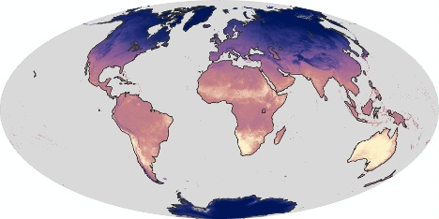
LST: Dec 2006

Slide 33
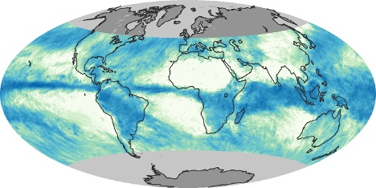
Precip: Dec 2006

Slide 34
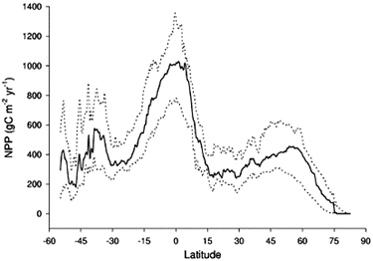
Latitudinal distribution of NPP

Slide 35
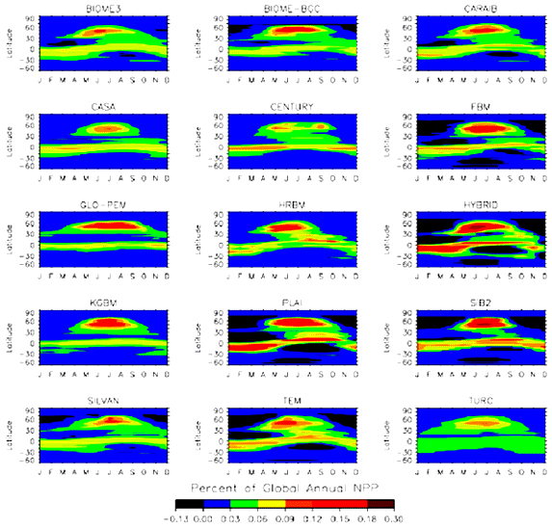
Latitudinal and time distribution NPP
Notes:
Since the total landmass (and in particular the vegetated landmass) in the Southern hemisphere is less than that of the Northern hemisphere, global NPP comes predominantly from Northern latitudes. Referring back to the plots of the annual cycle of atmospheric CO2 above, we noted a peak in May and a trough in October, largely then in response to global NPP increases in Spring and decreases in Autumn: the larger NPP in Northern hemisphere summer gradually decreases the atmospheric CO2 concentration. This is however complicated by the timing and spatial distribution of other CO2 sources and sinks.

Slide 36
Net Ecosystem Productivity
NEP = NPP minus other losses
respiration by heterotrophs (organisms – fungi, animals and bacteria in the soil),
other losses to the ecosystem such as through fire, insects, herbivory, and of course humans
QUESTION: What is the total fraction of global NPP appropriated by humans?

Slide 37
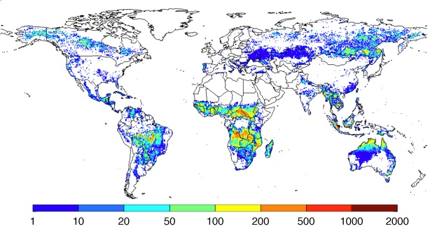
Fire: emissions g C m⁻² yr⁻¹
1997-2009
Notes:
Annual carbon emissions (as g C m-2 year-1), averaged over 1997-2009. These emissions estimates are build combining burned area data from above with a biogeochemical model (CASA-GFED) that estimates fuel loads and combustion completeness for each monthly time step. These fuel loads are based on satellite derived information on vegetation characteristics and productivity to estimate carbon input, and carbon outputs through heterotrophic respiration, herbivory, and fires

Slide 38
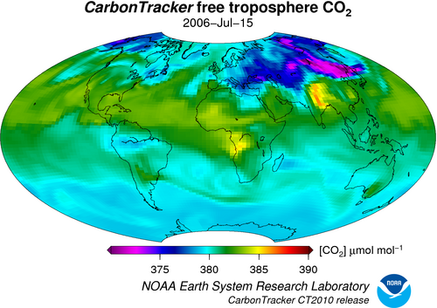
Atmos CO2
Notes:
Quite small range really (well-mixed) + rather different to NPP distributions … discuss??

Slide 39
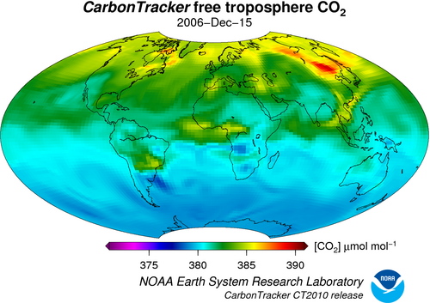
Atmos CO2

Slide 40
summary
looked in detail at the terrestrial carbon cycle:
Terms you need to understand:
NPP, GPP, NEP
Plus measurements / units
Patterns:
Spatial and temporal patterns

Slide 41
Reading
Ryu et al., 2019, What is global photosynthesis? History, uncertainties and opportunities,Remote Sensing of Environment, https://doi.org/10.1016/j.rse.2019.01.016.
Heimann, M., Reichstein, M. Terrestrial ecosystem carbon dynamics and climate feedbacks. Nature 451, 289–292 (2008). https://doi.org/10.1038/nature06591
Forests and Climate Change: Forcings, Feedbacks, and the Climate Benefits of Forests, G.B. Bonan, Science 320, 1444 (2008), DOI: 10.1126/science.1155121
IPCC AR5, Chapter 6: Carbon and Other Biogeochemical Cycles

Slide 42
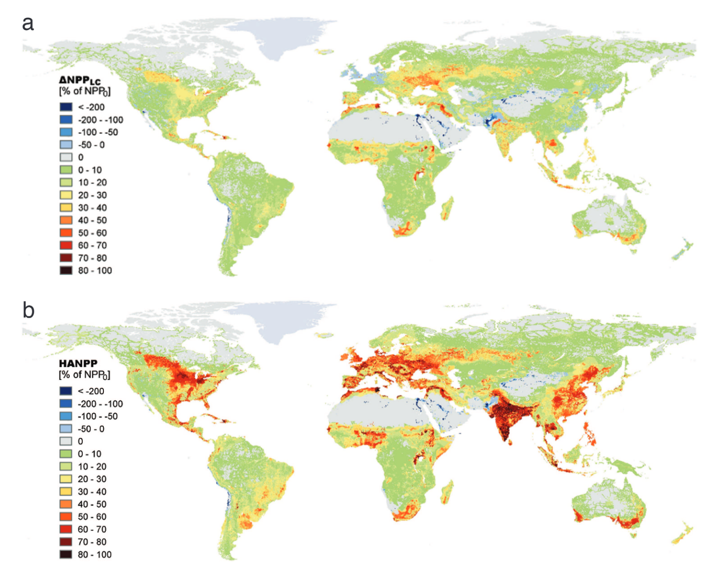
Net Ecosystem Productivity
QUESTION: What is the total fraction of global NPP appropriated by humans?
Haberl, H. et al. (2007)
Human Affected NPP
53% was contributed by harvest
40% by land-use-induced productivity changes
7% from fires

